Slide 1
Tutorial #3 H8s/2000 Instruction set
Dr. Sundaram Suresh Microprocessor Programming

Slide 2
H8S/2000 Instruction Set
H8S/2000 CPU has 65 instructions in 8 groups
Data transfer -
Arithmetic operations
Logic operations
Shift
Bit manipulation
Branch
System control
Block Data transfer
Depends on the type of instructions they can handle byte (B), word (w) and long word(L)
Notes:
Objectives for instruction and expected results and/or skills developed from learning.

Slide 3
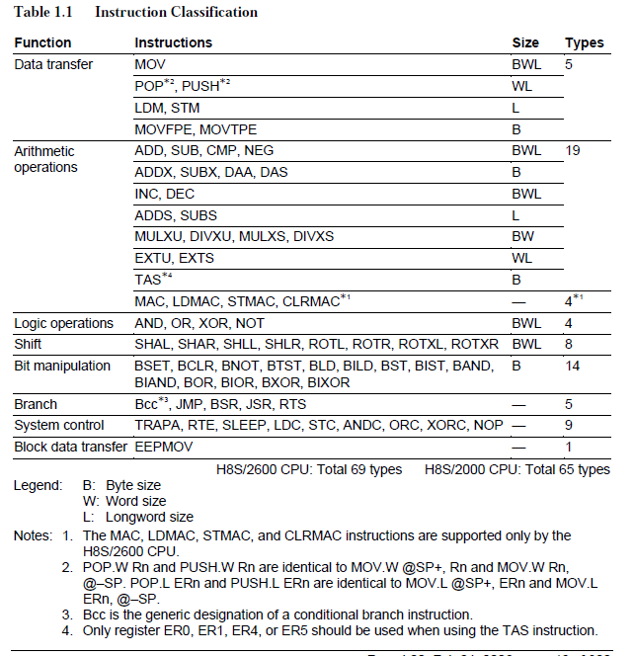
Instruction Classification
Notes:
Relative vocabulary list.

Slide 4
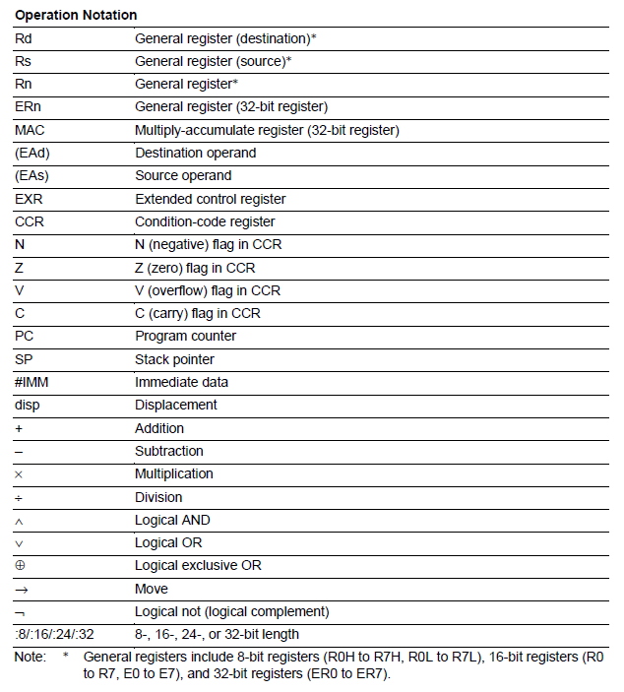
Operation Notation
Notes:
A list of procedures and steps, or a lecture slide with media.

Slide 5
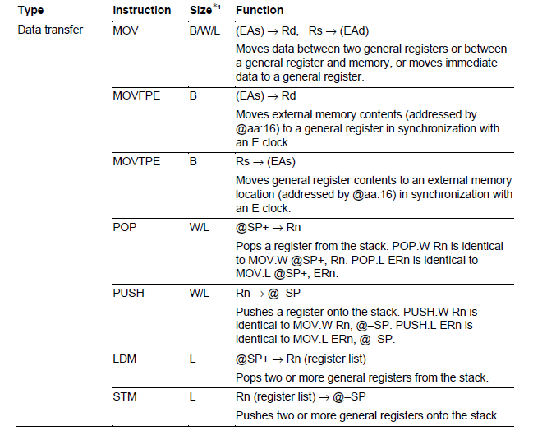
Instruction classified by function
Notes:
Example graph/chart.

Slide 6
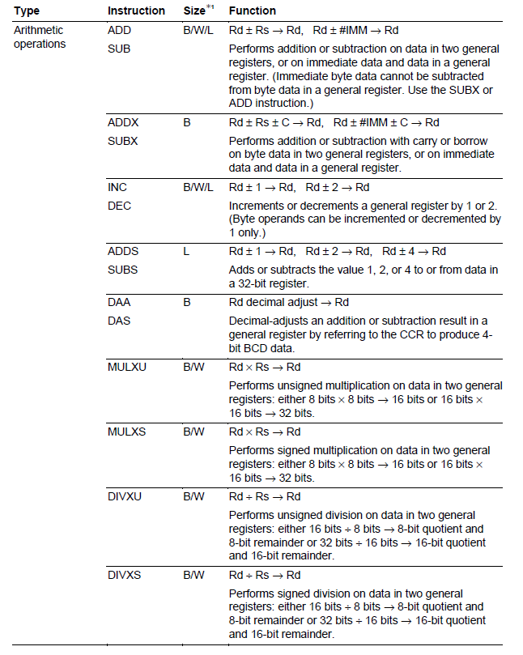
Instruction classified by function
Notes:
Example graph/chart.

Slide 7
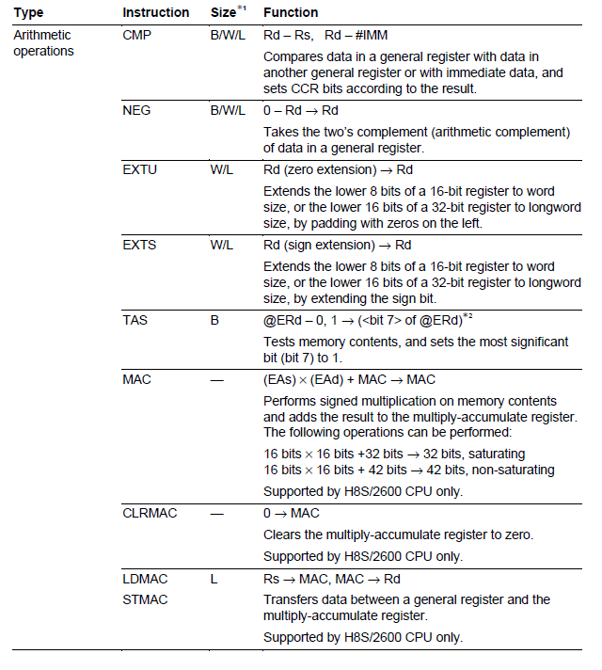
Instruction classified by function
Notes:
Conclusion to course, lecture, et al.

Slide 8
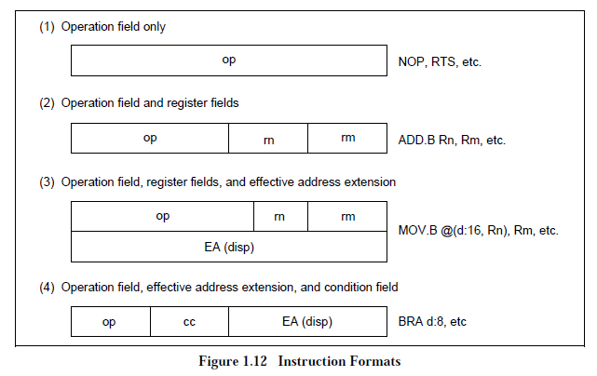
Instruction Format
Instruction consist of 2-byte units
Operation field – first 4 bits of the instruction
Register field – 3 or 4 bits
Effective address extension – 16 or 32 bits
Condition field – branching conditions

Slide 9
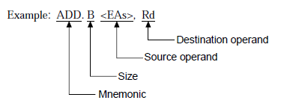
Assembly language format
Operand is ADD
Operand size – byte
<EA> - different type of register address for source operand
Register direct
Register indirect
Immediate
Absolute address and
……

Slide 10
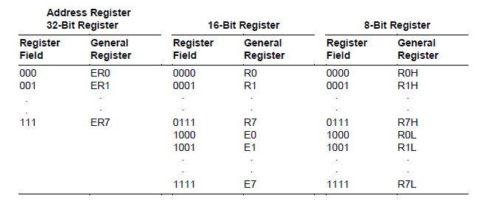
How to address the register in H8S/2000

Slide 11
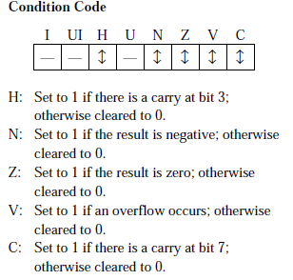
Understanding the instructions
Add.b <EAs> Rd
Byte size operand, Rd- register destination, <EAs> source register
Available registers
Rd: R0L to R7L, R0H to R7H
Rs: R0L to R7L, R0H to R7H
Address length
4 bits

Slide 12
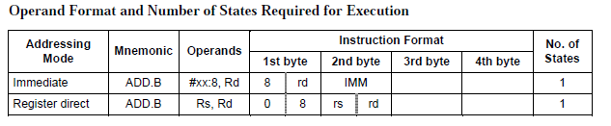
Understanding the instructions
Register for source can be of two types.
Register direct
Immediate
Machine code for “ADD.B”

Slide 13
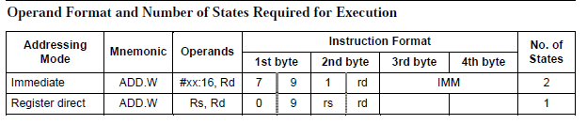
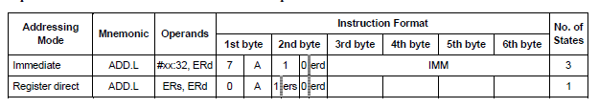
Understanding instructions
ADD.W <RAs>, Rd
ADD.L <RAs>, Rd

